Slide 1
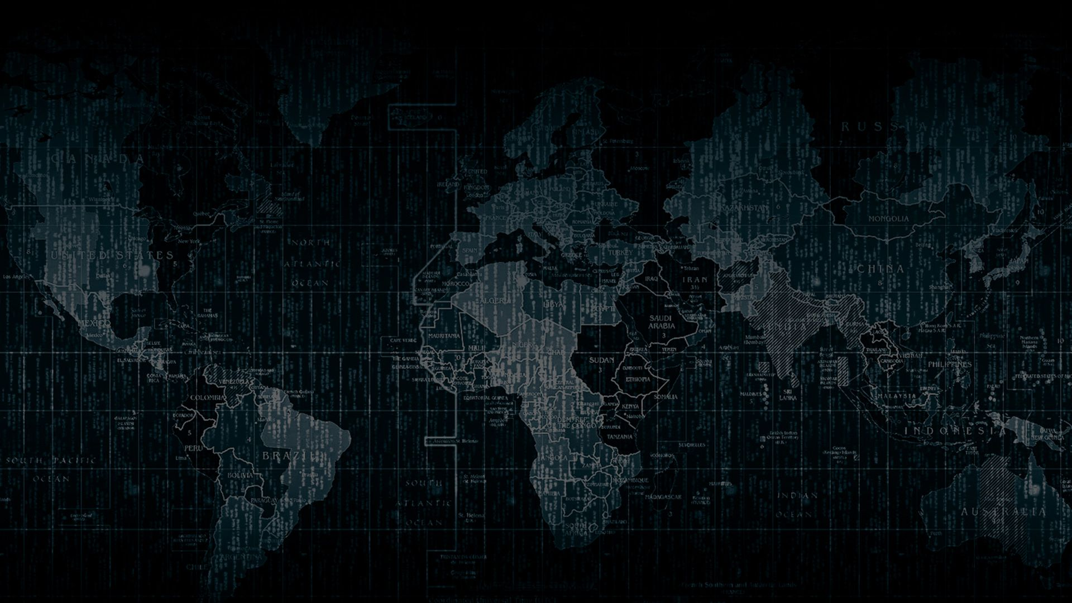

Solution By: THICK THREAT
PSID: INTL-FCD-15
Team Leader Name: Surya Narayanan CS

Slide 2

Idea Introduction
God’s Eye
Tech Stack
1. GAN
2. AI/ML
Resources Used
1. Deep Learning
2. Tensor Flow
Third party API used:
Deepware
Deepfake Detection-Outline
Problem Statement:
IDENTIFICATION OF ARTIFICIALLY GENERATED DEEPFAKE CONTENT.
Our Objective:
To build a solution that can automatically intimate the user if the probability of the content being deepfake is high.

Slide 3

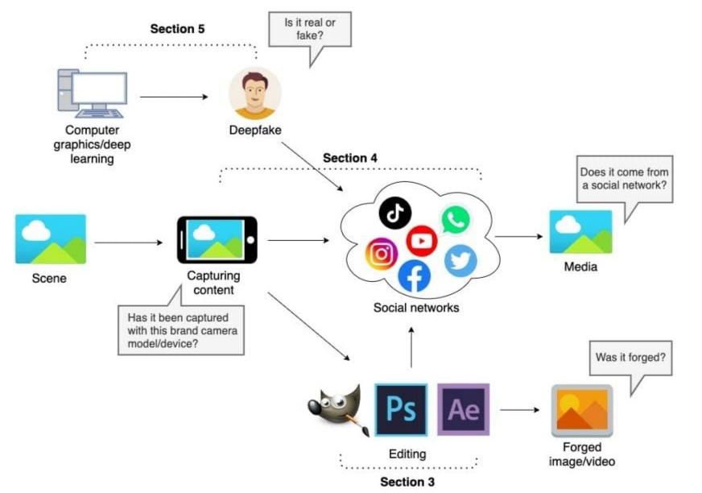
Our Approach Towards Idea
Our Approach and our Innovation
Approach
With the rapid development of face synthesis technology, the security threat brought by face tampering is becoming more and more serious.
Our Innovation
Our fake detection algorithm will automatically intimate the users if the video is artificially generated.
Requirements
1.Tensor Flow
2.Deep Learning & AI/ML Algorithms
3.GAN
Notes:
Use any image of your proposed solution here instead of this macbook image

Slide 4

Team Slide
Mentor : Anand R
Assistant Professor
Department of ECE
Sona College of Technology
Surya Narayanan CS
II nd year, ECE
Sona College of Technology
Rithvkailas G
II nd year, ECE
Sona College of Technology
Rubiga SA
II nd year, ECE
Sona College of Technology
Shurthika R
IL nd year, ECE
Sona College of Technology

Slide 5
Development Pipeline
Documents To be prepared for installation and evaluation
1. Deep learning algorithm.
2. AI/ML algorithm
3. Tensor Flow
Any Third party API used, if yes please specify
Deepware
Proposed Development Plan in pointers
1. Upload video
2. Splitting into frames
3. Face Detection
4. Load Trained model
5. Intimates the user if it is deepfake.
This is the reference of our idea
https://arxiv.org/ftp/arxiv/papers/2103/2103.00484.pdf
Proposed UI and functional flow in pointers
1. Data Splitting
2. Data Loader
3. ResNext Feature extraction
4. LSTM video classification
Step A
Step B
Step C
Step D
Step E

Slide 6
Vision of Innovation/Idea/Solution
Today we live in a “post-truth” era, where a piece of information or disinformation is utilized by malevolent actors to manipulate public opinion. Disinformation is an active measure that has the potential to cause severe damage. Misinformation is defined as false or inaccurate information that is communicated, regardless of an intention to deceive. This makes us to develop this idea.
Innovation
Apart from detecting whether the content is fake or real, our detection algorithm provides a probability whether it is deep fake or not. If the probability of deepfake is high, it automatically intimates the user about it and restricts the user to upload the content.
Time Duration
Initial Innovation
An innovation process always starts with the search for and finding innovative potentials and the derivation of ideas. First we thought of detecting the deepfake, while the development was going on we came to an innovative idea of intimating the user about their content using our algorithm which will be much more feasible for this problem statement.
Since we are using Deep Learning algorithm to detect the Deepfake , it doesn’t require lot of time to complete. It would approximately require a month to give the final product.

